Slide 1
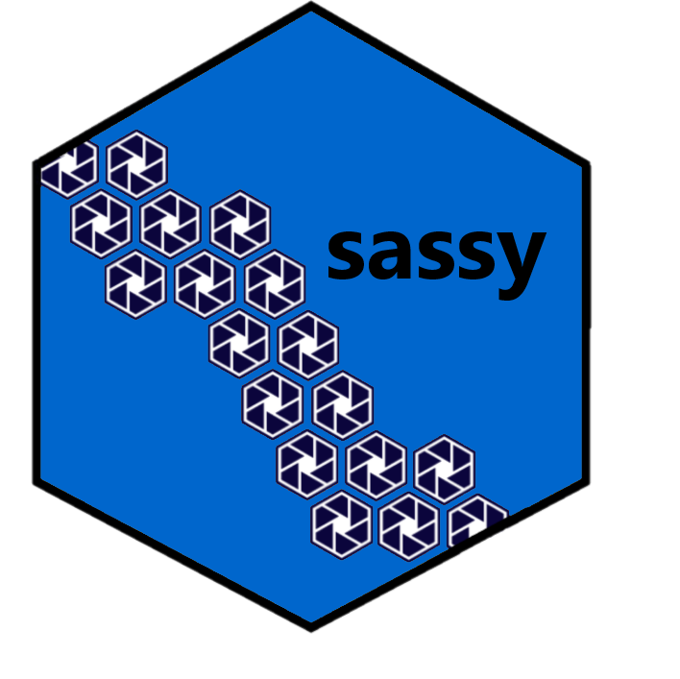
Introduction to R
Tibbles

Slide 2
Key Points
Tidyverse is a family of packages developed by RStudio
A tibble is an enhanced data frame used by Tidyverse
Tibbles have nicer printing
Tibble subsetting always returns a tibble

Slide 3
Suggested Exercises
Create a tibble from a sample dataset
Print the tibble and observe the results
Practice subsetting the tibble

Slide 4
Introduction to R
Tibbles

